Slide 1
Value signals in the orbitofrontal cortex incorporate reference-dependent surprise utility
Brenden Eum *slides
Zeynep Enkavi
John O’Doherty
Antonio Rangel

Slide 2

1

Slide 3



1
Congrats! Welcome to the firm.
We are offering $85,000.
You start next month.
$75,000

Slide 4


2

Slide 5

Experienced utility…
at time of news
at time of consumption
1
2

Slide 6
Experienced utility…
at time of news
at time of consumption
Surprise Experienced Utility (sEU)
Consumption Experienced Utility (cEU)
Surprise Experienced Utility

Slide 7
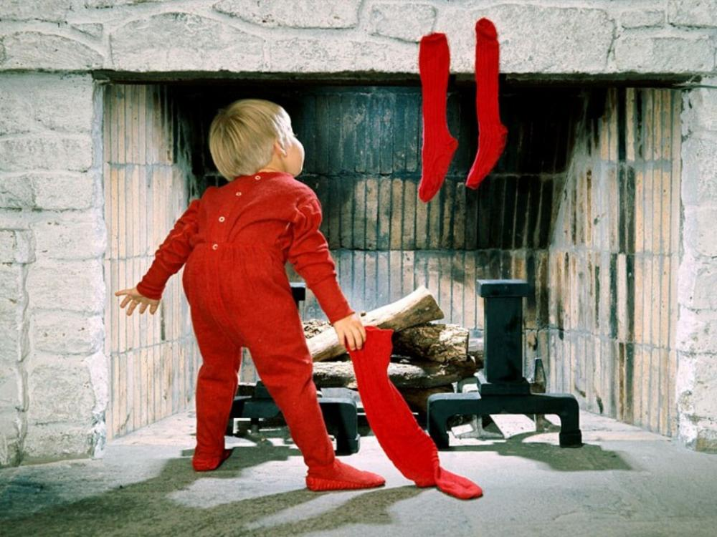
sEU is NOT anticipation
at time of news
at time of consumption

Slide 8
Is experienced utility only influenced by outcomes, or also by beliefs?

Slide 9
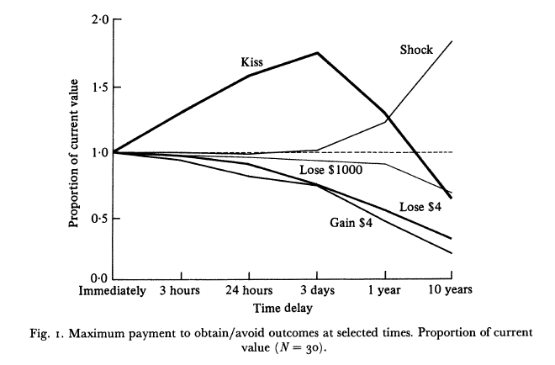
Anticipation
Lowenstein (1987, Econ J)

Slide 10

News utility: Household investor behavior
Household investors are inattentive to their portfolios and exhibit greater trading inactivity during downswings than upswings (Bilias, Geogarakos, & Haliassos, 2010, JMCB).
If investors experience loss-averse news utility, then they have an incentive to ignore their portfolio if they expect bad news (Pagel, 2018, Econometrica).
Nachum Sicherman: “ostrich behavior”

Slide 11
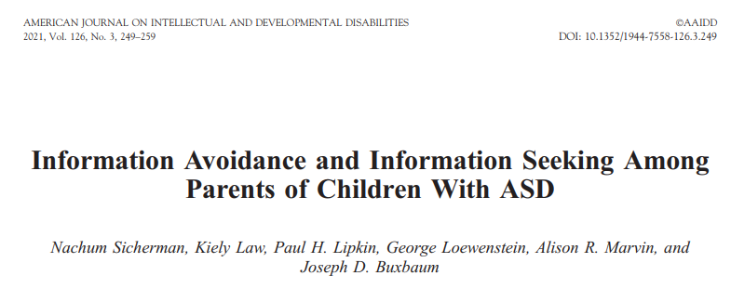
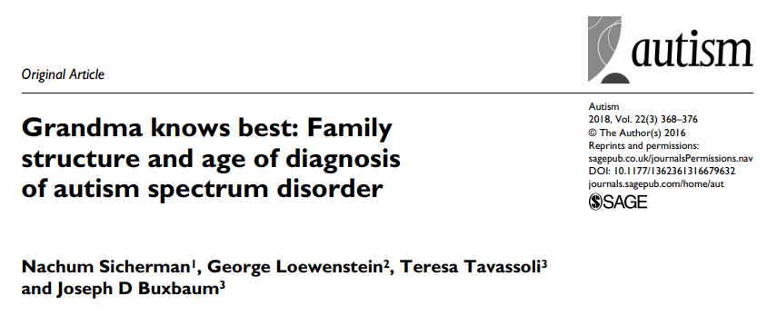
News utility: Early detection in Autism diagnosis
“Many parents avoid seeking help to find a diagnosis for their child, even though they sense something might be wrong. They often ignore signs of a larger problem and look the other way, making the role of close family members and friends vital to accelerating diagnosis and helping a child’s condition.” Nachum Sicherman (2017)
Frequent interaction with grandma reduces age of ASD diagnosis by 5.18 months.

Slide 12

News utility: Anecdotal
“I’m going to wait until after vacation to check my grade.”

Slide 13
Beliefs and preferences
Disappointment aversion [Bell (1985), Loomes & Sugden (1986)]
Information preferences and attention [Golman & Lowenstein (2016)]
Reference-dependent preferences [Koszegi & Rabin (2006, 2007)]
Reference-dependent news utility [Koszegi & Rabin (2009)]

Slide 14
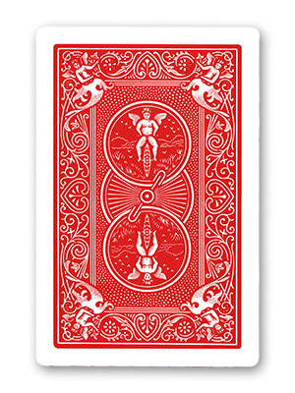
Testing information preferences
Falk & Zimmerman (2022, Manag Sci)
immediately after picking
right before consumption period

Slide 15
Testing information preferences
Falk & Zimmerman (2022, Manag Sci)
immediately after picking
right before consumption period
DISTRACTION

Slide 16
Testing information preferences
Falk & Zimmerman (2022, Manag Sci)
all at once
immediately after picking

Slide 17
Testing information preferences
Falk & Zimmerman (2022, Manag Sci)
all at once
immediately after picking
Any rational preference relation on a finite set has a utility representation [follows from Claim 1 on pg. 14 of Rubinstein (2016)].
Experimental evidence supports loss-averse news utility [Koszegi & Rabin (2009)].

Slide 18
Testing information preferences
Falk & Zimmerman (2022, Manag Sci)
Only used aversive outcomes.
Does not give any insight on the functional form of news utility.
Is news utility reference-dependent, as in Koszegi & Rabin (2009)?

Slide 19
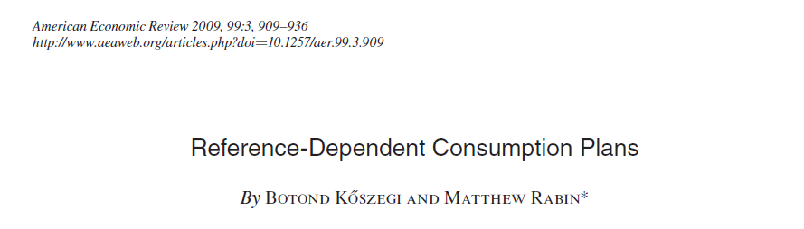
“KR news utility”

Slide 20
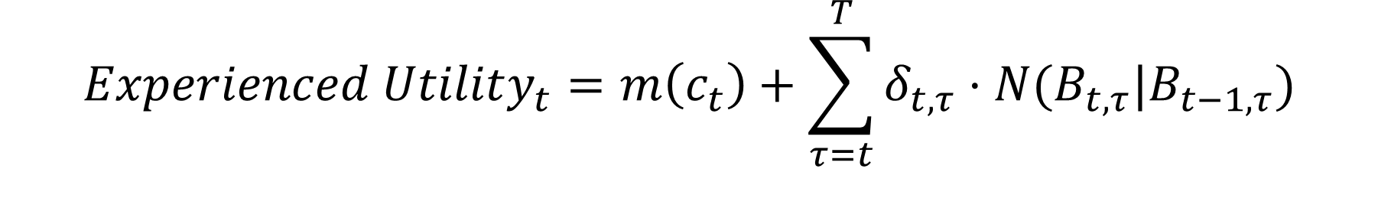
$$Experienced Utility_{t}=m\left(c_{t}\right)+\sum_{τ=t}^{T}{δ_{t,τ}⋅N(B_{t,τ}|B_{t−1, τ})}$$
cEU
discounting
changes in beliefs about future consumption
beliefs inherited from time $t−1$ about consumption at time $τ$
Let N be some function of the difference in expected consumption
in the form of a “universal gain-loss utility function”:
Bowman, Minehart, and Rabin (1999)
Kahneman and Tversky (1979)

Slide 21
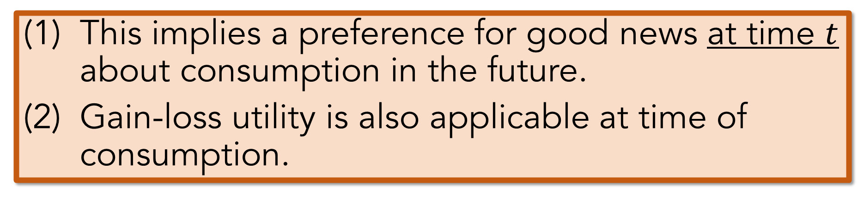
$$Experienced Utility_{t}=m\left(c_{t}\right)+\sum_{τ=t}^{T}{δ_{t,τ}⋅N(B_{t,τ}|B_{t−1, τ})}$$
cEU
sEU
This implies a preference for good news at time $t$ about consumption in the future.
Gain-loss utility is also applicable at time of consumption.

Slide 22

But wait a second…
Isn’t sEU just TD RPE?
No!
all at once
immediately after picking
$$≽$$

Slide 23
Goals
Behavioral economics
Test the functional form of reference-dependent news utility from Koszegi & Rabin (2009).
Test if news utility holds with appetitive outcomes, not just aversive outcomes.
Neuroscience
3. Test if value signals in the brain encode KR news utility.

Slide 24
Hypothesis: Value signals in the OFC incorporate reference-dependent surprise utility

Slide 25
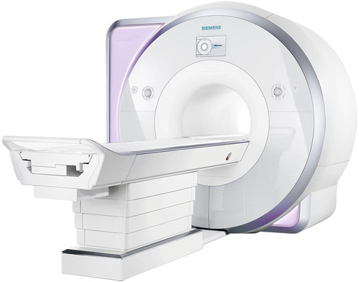

Viewing task
144 trials
2 blocks
Fractal choice task
24 trials
1 block
Rating task
72 trials
1 block
25 mins
2.5 mins
9 mins

Slide 26
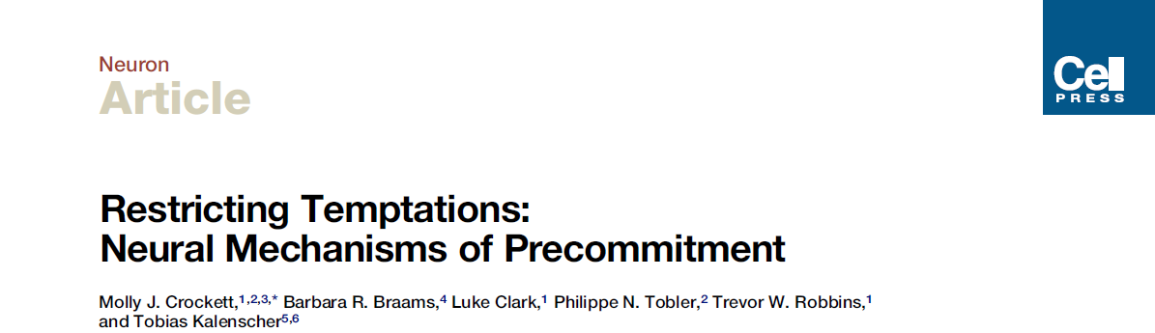

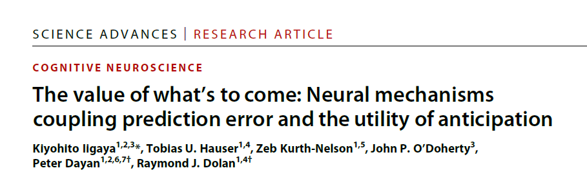
Subjects & stimulus set
Heterosexual male subjects.
72 images of women in lingerie.
Crockett et al. (2013), Sescouse et al. (2013), and informal confirmation from Kiyo that heterosexual male vmPFC lights up upon presentation of these types of stimuli.

Slide 27

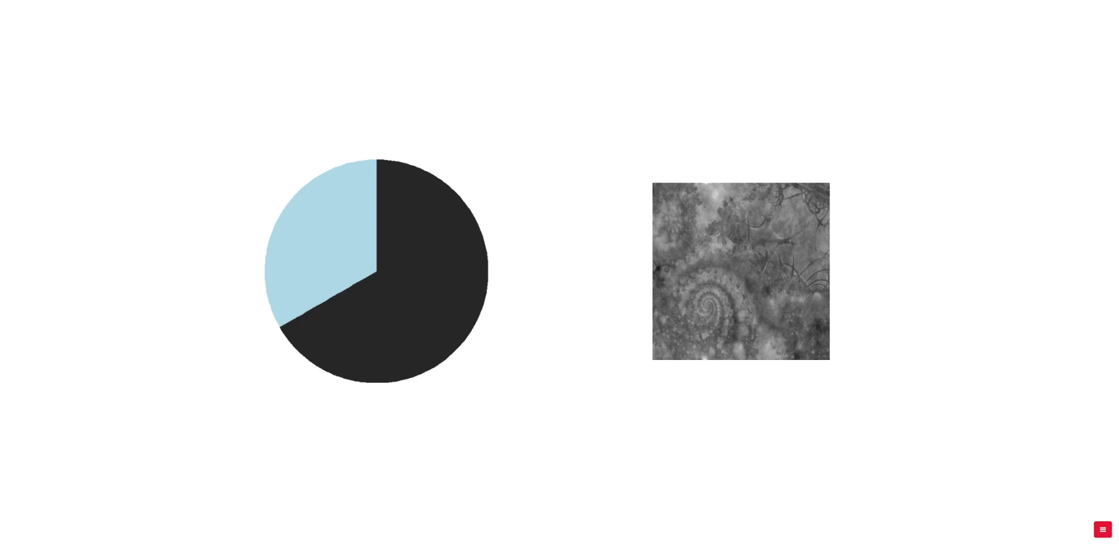

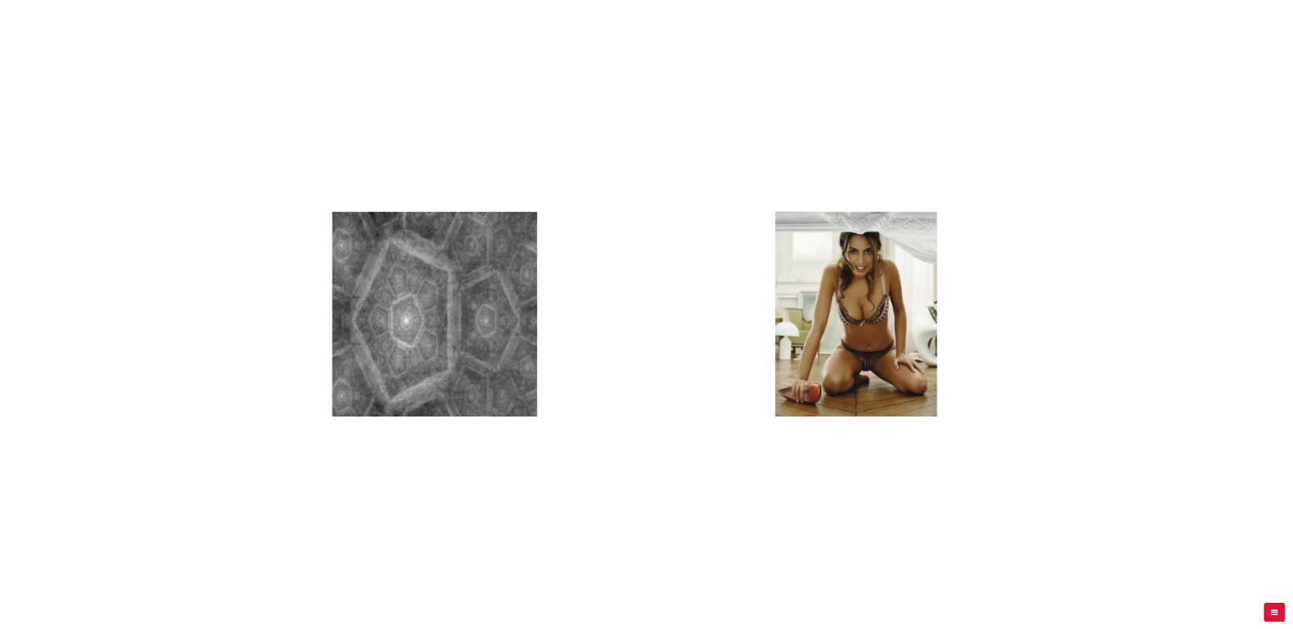

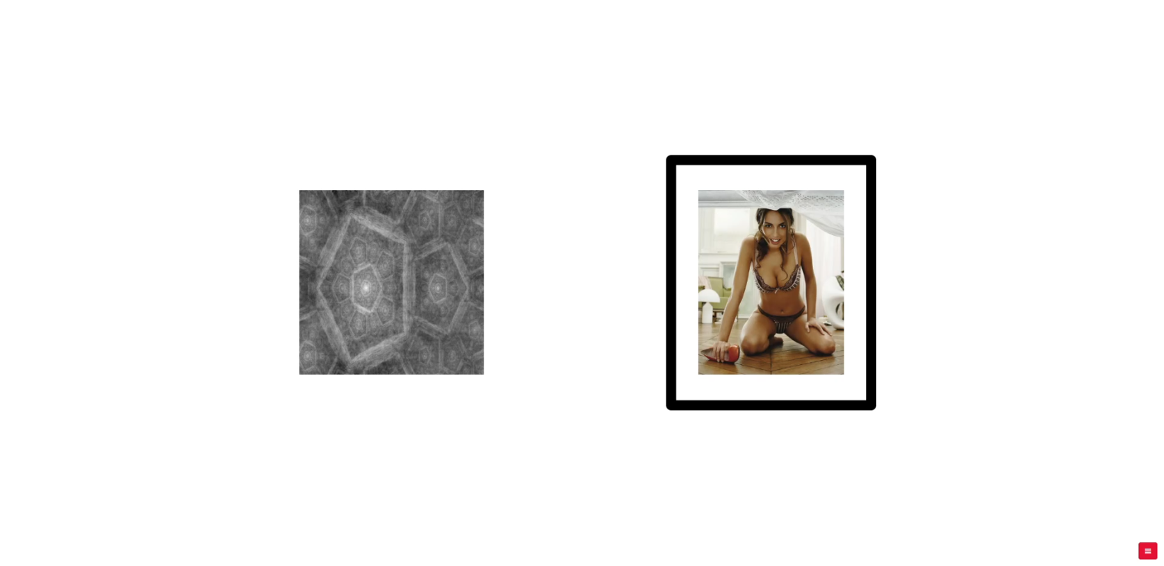
Viewing Task
Fixation
Unif(1,5) s
Information
1 s
Wait
{1,2,3,4} s
Outcome
2 s
Feedback
(part of the 2 s)

Slide 28

Viewing Task
Fixation
Unif(1,5) s
Information
1 s
Wait
{1,2,3,4} s
Outcome
2 s
Feedback
(part of the 2 s)

Slide 29
Viewing Task
Fixation
Unif(1,5) s
Information
1 s
Wait
{1,2,3,4} s
Outcome
2 s
Feedback
(part of the 2 s)

Slide 30
Viewing Task Conditions
Probability (P) |  | 1 | 2/3 | 1/3 | 0
Block H E[P]=2/3 | Proportion | 1/3 | 1/3 | 1/3 | -
 | Reward | 24 | 16 | 8 | -
 | No Reward | - | 8 | 16 | -
Block L E[P]=1/3 | Proportion | - | 1/3 | 1/3 | 1/3
 | Reward | - | 16 | 8 | -
 | No Reward | - | 8 | 16 | 24

Slide 31
Why these conditions?
Probability (P) |  | 1 | 2/3 | 1/3 | 0
Block H | Proportion | 1/3 | 1/3 | 1/3 | -
Block L | Proportion | - | 1/3 | 1/3 | 1/3
Context | H |  |  | L
Probability | 1 | 2/3 | 1/3 | 2/3 | 1/3 | 0
EU = cEU | 0 | 0 | 0 | 0 | 0 | 0
EU = cEU + sEU | 0+1/3 | 0+0 | 0-1/3 | 0+1/3 | 0+0 | 0-1/3
@ info screen
Outcome | Reward |  |  | No Reward
Probability | 1 | 2/3 | 1/3 | 2/3 | 1/3 | 0
EU = cEU | 1 | 1 | 1 | 0 | 0 | 0
EU = cEU + sEU | 1+0 | 1+1/3 | 1+2/3 | 0-2/3 | 0-1/3 | 0+0
@ outcome screen

Slide 32
Probability (P) |  | 1 | 2/3 | 1/3 | 0
Block H E[P]=2/3 | Proportion | 1/3 | 1/3 | 1/3 | -
 | Reward | 24 | 16 | 8 | -
 | No Reward | - | 8 | 16 | -
Block L E[P]=1/3 | Proportion | - | 1/3 | 1/3 | 1/3
 | Reward | - | 16 | 8 | -
 | No Reward | - | 8 | 16 | 24
F(Reward, P=1)
F(No Reward, P=0)
F(Reward, P=1/3)
F(No Reward, P=1/3)
F(H, P=1)
F(H, P=1/3)
F(L, P=1/3)
Context | H |  |  | L
Probability | 1 | 2/3 | 1/3 | 2/3 | 1/3 | 0
EU = cEU | 0 | 0 | 0 | 0 | 0 | 0
EU = cEU + sEU | 1/3 | 0 | -1/3 | 1/3 | 0 | -1/3
@ info screen
Outcome | Reward |  |  | No Reward
Probability | 1 | 2/3 | 1/3 | 2/3 | 1/3 | 0
EU = cEU | 1 | 1 | 1 | 0 | 0 | 0
EU = cEU + sEU | 1 | 1 1/3 | 1 2/3 | -2/3 | -1/3 | 0
@ outcome screen

Slide 33
Probability (P) |  | 1 | 2/3 | 1/3 | 0
Block H E[P]=2/3 | Proportion | 1/3 | 1/3 | 1/3 | -
 | Reward | 24 | 16 | 8 | -
 | No Reward | - | 8 | 16 | -
Block L E[P]=1/3 | Proportion | - | 1/3 | 1/3 | 1/3
 | Reward | - | 16 | 8 | -
 | No Reward | - | 8 | 16 | 24
F(Reward, P=1)
F(No Reward, P=0)
F(Reward, P=1/3)
F(No Reward, P=1/3)
F(H, P=1)
F(H, P=1/3)
F(L, P=1/3)
Context | H |  |  | L
Probability | 1 | 2/3 | 1/3 | 2/3 | 1/3 | 0
EU = cEU | 0 | 0 | 0 | 0 | 0 | 0
EU = cEU + sEU | 1/3 | 0 | -1/3 | 1/3 | 0 | -1/3
@ info screen
Outcome | Reward |  |  | No Reward
Probability | 1 | 2/3 | 1/3 | 2/3 | 1/3 | 0
EU = cEU | 1 | 1 | 1 | 0 | 0 | 0
EU = cEU + sEU | 1 | 1 1/3 | 1 2/3 | -2/3 | -1/3 | 0
@ outcome screen

Slide 34
Probability (P) |  | 1 | 2/3 | 1/3 | 0
Block H E[P]=2/3 | Proportion | 1/3 | 1/3 | 1/3 | -
 | Reward | 24 | 16 | 8 | -
 | No Reward | - | 8 | 16 | -
Block L E[P]=1/3 | Proportion | - | 1/3 | 1/3 | 1/3
 | Reward | - | 16 | 8 | -
 | No Reward | - | 8 | 16 | 24
F(Reward, P=1)
F(No Reward, P=0)
F(Reward, P=1/3)
F(No Reward, P=1/3)
F(H, P=1)
F(H, P=1/3)
F(L, P=1/3)
Context | H |  |  | L
Probability | 1 | 2/3 | 1/3 | 2/3 | 1/3 | 0
EU = cEU | 0 | 0 | 0 | 0 | 0 | 0
EU = cEU + sEU | 1/3 | 0 | -1/3 | 1/3 | 0 | -1/3
@ info screen
Outcome | Reward |  |  | No Reward
Probability | 1 | 2/3 | 1/3 | 2/3 | 1/3 | 0
EU = cEU | 1 | 1 | 1 | 0 | 0 | 0
EU = cEU + sEU | 1 | 1 1/3 | 1 2/3 | -2/3 | -1/3 | 0
@ outcome screen

Slide 35
Probability (P) |  | 1 | 2/3 | 1/3 | 0
Block H E[P]=2/3 | Proportion | 1/3 | 1/3 | 1/3 | -
 | Reward | 24 | 16 | 8 | -
 | No Reward | - | 8 | 16 | -
Block L E[P]=1/3 | Proportion | - | 1/3 | 1/3 | 1/3
 | Reward | - | 16 | 8 | -
 | No Reward | - | 8 | 16 | 24
F(Reward, P=1)
F(No Reward, P=0)
F(Reward, P=1/3)
F(No Reward, P=1/3)
F(H, P=1)
F(H, P=1/3)
F(L, P=1/3)
Context | H |  |  | L
Probability | 1 | 2/3 | 1/3 | 2/3 | 1/3 | 0
EU = cEU | 0 | 0 | 0 | 0 | 0 | 0
EU = cEU + sEU | 1/3 | 0 | -1/3 | 1/3 | 0 | -1/3
@ info screen
Outcome | Reward |  |  | No Reward
Probability | 1 | 2/3 | 1/3 | 2/3 | 1/3 | 0
EU = cEU | 1 | 1 | 1 | 0 | 0 | 0
EU = cEU + sEU | 1 | 1 1/3 | 1 2/3 | -2/3 | -1/3 | 0
@ outcome screen

Slide 36
Probability (P) |  | 1 | 2/3 | 1/3 | 0
Block H E[P]=2/3 | Proportion | 1/3 | 1/3 | 1/3 | -
 | Reward | 24 | 16 | 8 | -
 | No Reward | - | 8 | 16 | -
Block L E[P]=1/3 | Proportion | - | 1/3 | 1/3 | 1/3
 | Reward | - | 16 | 8 | -
 | No Reward | - | 8 | 16 | 24
F(Reward, P=1)
F(No Reward, P=0)
F(Reward, P=1/3)
F(No Reward, P=1/3)
F(H, P=1)
F(H, P=1/3)
F(L, P=1/3)
Context | H |  |  | L
Probability | 1 | 2/3 | 1/3 | 2/3 | 1/3 | 0
EU = cEU | 0 | 0 | 0 | 0 | 0 | 0
EU = cEU + sEU | 1/3 | 0 | -1/3 | 1/3 | 0 | -1/3
@ info screen
Outcome | Reward |  |  | No Reward
Probability | 1 | 2/3 | 1/3 | 2/3 | 1/3 | 0
EU = cEU | 1 | 1 | 1 | 0 | 0 | 0
EU = cEU + sEU | 1 | 1 1/3 | 1 2/3 | -2/3 | -1/3 | 0
@ outcome screen

Slide 37
Probability (P) |  | 1 | 2/3 | 1/3 | 0
Block H E[P]=2/3 | Proportion | 1/3 | 1/3 | 1/3 | -
 | Reward | 24 | 16 | 8 | -
 | No Reward | - | 8 | 16 | -
Block L E[P]=1/3 | Proportion | - | 1/3 | 1/3 | 1/3
 | Reward | - | 16 | 8 | -
 | No Reward | - | 8 | 16 | 24
F(Reward, P=1)
F(No Reward, P=0)
F(Reward, P=1/3)
F(No Reward, P=1/3)
F(H, P=1)
F(H, P=1/3)
F(L, P=1/3)
Context | H |  |  | L
Probability | 1 | 2/3 | 1/3 | 2/3 | 1/3 | 0
EU = cEU | 0 | 0 | 0 | 0 | 0 | 0
EU = cEU + sEU | 1/3 | 0 | -1/3 | 1/3 | 0 | -1/3
@ info screen
Outcome | Reward |  |  | No Reward
Probability | 1 | 2/3 | 1/3 | 2/3 | 1/3 | 0
EU = cEU | 1 | 1 | 1 | 0 | 0 | 0
EU = cEU + sEU | 1 | 1 1/3 | 1 2/3 | -2/3 | -1/3 | 0
@ outcome screen

Slide 38
Probability (P) |  | 1 | 2/3 | 1/3 | 0
Block H E[P]=2/3 | Proportion | 1/3 | 1/3 | 1/3 | -
 | Reward | 24 | 16 | 8 | -
 | No Reward | - | 8 | 16 | -
Block L E[P]=1/3 | Proportion | - | 1/3 | 1/3 | 1/3
 | Reward | - | 16 | 8 | -
 | No Reward | - | 8 | 16 | 24
F(Reward, P=1)
F(No Reward, P=0)
F(Reward, P=1/3)
F(No Reward, P=1/3)
F(H, P=1)
F(H, P=1/3)
F(L, P=1/3)
Context | H |  |  | L
Probability | 1 | 2/3 | 1/3 | 2/3 | 1/3 | 0
EU = cEU | 0 | 0 | 0 | 0 | 0 | 0
EU = cEU + sEU | 1/3 | 0 | -1/3 | 1/3 | 0 | -1/3
@ info screen
Outcome | Reward |  |  | No Reward
Probability | 1 | 2/3 | 1/3 | 2/3 | 1/3 | 0
EU = cEU | 1 | 1 | 1 | 0 | 0 | 0
EU = cEU + sEU | 1 | 1 1/3 | 1 2/3 | -2/3 | -1/3 | 0
@ outcome screen

Slide 39
Probability (P) |  | 1 | 2/3 | 1/3 | 0
Block H E[P]=2/3 | Proportion | 1/3 | 1/3 | 1/3 | -
 | Reward | 24 | 16 | 8 | -
 | No Reward | - | 8 | 16 | -
Block L E[P]=1/3 | Proportion | - | 1/3 | 1/3 | 1/3
 | Reward | - | 16 | 8 | -
 | No Reward | - | 8 | 16 | 24
F(Reward, P=1)
F(No Reward, P=0)
F(Reward, P=1/3)
F(No Reward, P=1/3)
F(H, P=1)
F(H, P=1/3)
F(L, P=1/3)
Context | H |  |  | L
Probability | 1 | 2/3 | 1/3 | 2/3 | 1/3 | 0
EU = cEU | 0 | 0 | 0 | 0 | 0 | 0
EU = cEU + sEU | 1/3 | 0 | -1/3 | 1/3 | 0 | -1/3
@ info screen
Outcome | Reward |  |  | No Reward
Probability | 1 | 2/3 | 1/3 | 2/3 | 1/3 | 0
EU = cEU | 1 | 1 | 1 | 0 | 0 | 0
EU = cEU + sEU | 1 | 1 1/3 | 1 2/3 | -2/3 | -1/3 | 0
@ outcome screen

Slide 40
Model Predictions
Context | H |  |  | L
Probability | 1 | 2/3 | 1/3 | 2/3 | 1/3 | 0
EU = cEU | 0 | 0 | 0 | 0 | 0 | 0
EU = cEU + sEU | 1/3 | 0 | -1/3 | 1/3 | 0 | -1/3
Outcome | Reward |  |  | No Reward
Probability | 1 | 2/3 | 1/3 | 2/3 | 1/3 | 0
EU = cEU | 1 | 1 | 1 | 0 | 0 | 0
EU = cEU + sEU | 1 | 1 1/3 | 1 2/3 | -2/3 | -1/3 | 0
1 | F(Reward, P=1/3) | > | F(Reward, P=1)
2 | F(No Reward, P=0) | > | F(No Reward, P=1/3)
3 | F(H, P=1) | > | F(H, P=1/3)
4 | F(L, P=1/3) | > | F(H, P=1/3)
5 | F(L, P=1/3) | = | F(No Reward, P=0)
6 | F(H, P=1/3) | = | F(No Reward, P=1/3)

Slide 41
Model Predictions
Context | H |  |  | L
Probability | 1 | 2/3 | 1/3 | 2/3 | 1/3 | 0
EU = cEU | 0 | 0 | 0 | 0 | 0 | 0
EU = cEU + sEU | 1/3 | 0 | -1/3 | 1/3 | 0 | -1/3
Outcome | Reward |  |  | No Reward
Probability | 1 | 2/3 | 1/3 | 2/3 | 1/3 | 0
EU = cEU | 1 | 1 | 1 | 0 | 0 | 0
EU = cEU + sEU | 1 | 1 1/3 | 1 2/3 | -2/3 | -1/3 | 0
1 | F(Reward, P=1/3) | > | F(Reward, P=1)
2 | F(No Reward, P=0) | > | F(No Reward, P=1/3)
3 | F(H, P=1) | > | F(H, P=1/3)
4 | F(L, P=1/3) | > | F(H, P=1/3)
5 | F(L, P=1/3) | = | F(No Reward, P=0)
6 | F(H, P=1/3) | = | F(No Reward, P=1/3)

Slide 42
Model Predictions
Context | H |  |  | L
Probability | 1 | 2/3 | 1/3 | 2/3 | 1/3 | 0
EU = cEU | 0 | 0 | 0 | 0 | 0 | 0
EU = cEU + sEU | 1/3 | 0 | -1/3 | 1/3 | 0 | -1/3
Outcome | Reward |  |  | No Reward
Probability | 1 | 2/3 | 1/3 | 2/3 | 1/3 | 0
EU = cEU | 1 | 1 | 1 | 0 | 0 | 0
EU = cEU + sEU | 1 | 1 1/3 | 1 2/3 | -2/3 | -1/3 | 0
1 | F(Reward, P=1/3) | > | F(Reward, P=1)
2 | F(No Reward, P=0) | > | F(No Reward, P=1/3)
3 | F(H, P=1) | > | F(H, P=1/3)
4 | F(L, P=1/3) | > | F(H, P=1/3)
5 | F(L, P=1/3) | = | F(No Reward, P=0)
6 | F(H, P=1/3) | = | F(No Reward, P=1/3)

Slide 43
Model Predictions
Context | H |  |  | L
Probability | 1 | 2/3 | 1/3 | 2/3 | 1/3 | 0
EU = cEU | 0 | 0 | 0 | 0 | 0 | 0
EU = cEU + sEU | 1/3 | 0 | -1/3 | 1/3 | 0 | -1/3
Outcome | Reward |  |  | No Reward
Probability | 1 | 2/3 | 1/3 | 2/3 | 1/3 | 0
EU = cEU | 1 | 1 | 1 | 0 | 0 | 0
EU = cEU + sEU | 1 | 1 1/3 | 1 2/3 | -2/3 | -1/3 | 0
1 | F(Reward, P=1/3) | > | F(Reward, P=1)
2 | F(No Reward, P=0) | > | F(No Reward, P=1/3)
3 | F(H, P=1) | > | F(H, P=1/3)
4 | F(L, P=1/3) | > | F(H, P=1/3)
5 | F(L, P=1/3) | = | F(No Reward, P=0)
6 | F(H, P=1/3) | = | F(No Reward, P=1/3)

Slide 44
Model Predictions
Context | H |  |  | L
Probability | 1 | 2/3 | 1/3 | 2/3 | 1/3 | 0
EU = cEU | 0 | 0 | 0 | 0 | 0 | 0
EU = cEU + sEU | 1/3 | 0 | -1/3 | 1/3 | 0 | -1/3
Outcome | Reward |  |  | No Reward
Probability | 1 | 2/3 | 1/3 | 2/3 | 1/3 | 0
EU = cEU | 1 | 1 | 1 | 0 | 0 | 0
EU = cEU + sEU | 1 | 1 1/3 | 1 2/3 | -2/3 | -1/3 | 0
1 | F(Reward, P=1/3) | > | F(Reward, P=1)
2 | F(No Reward, P=0) | > | F(No Reward, P=1/3)
3 | F(H, P=1) | > | F(H, P=1/3)
4 | F(L, P=1/3) | > | F(H, P=1/3)
5 | F(L, P=1/3) | = | F(No Reward, P=0)
6 | F(H, P=1/3) | = | F(No Reward, P=1/3)

Slide 45
Model Predictions
Context | H |  |  | L
Probability | 1 | 2/3 | 1/3 | 2/3 | 1/3 | 0
EU = cEU | 0 | 0 | 0 | 0 | 0 | 0
EU = cEU + sEU | 1/3 | 0 | -1/3 | 1/3 | 0 | -1/3
Outcome | Reward |  |  | No Reward
Probability | 1 | 2/3 | 1/3 | 2/3 | 1/3 | 0
EU = cEU | 1 | 1 | 1 | 0 | 0 | 0
EU = cEU + sEU | 1 | 1 1/3 | 1 2/3 | -2/3 | -1/3 | 0
1 | F(Reward, P=1/3) | > | F(Reward, P=1)
2 | F(No Reward, P=0) | > | F(No Reward, P=1/3)
3 | F(H, P=1) | > | F(H, P=1/3)
4 | F(L, P=1/3) | > | F(H, P=1/3)
5 | F(L, P=1/3) | = | F(No Reward, P=0)
6 | F(H, P=1/3) | = | F(No Reward, P=1/3)

Slide 46


Fractal Choice Task
Fixation
1 s
Choice
$≤$2 s
Wait
{1,2,3,4} s
Outcome
2 s

Slide 47

Fractal Choice Task
Fixation
1 s
Choice
$≤$2 s
Wait
{1,2,3,4} s
Outcome
2 s
Test each of the 6 predictions 4 times = 24 trials

Slide 48
Rating Task
Fixation
1 s
Discrete ratings
-1
Dislike
0
Neutral
3
Really Like
Rating
Free RT

Slide 49
If you can test for sEU using the (behavioral) fractal choice task, why bother collecting fMRI data?

Slide 50
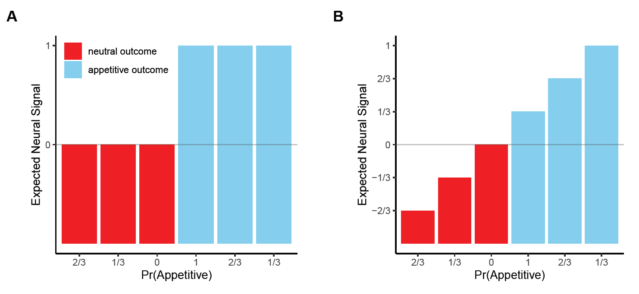
1. to show that value signals in OFC incorporate sEU

Slide 51
2. to differentiate sEU from anticipation utility
Fixation
Unif(1,5) s
Information
1 s
Wait
{1,2,3,4} s
sEU
no sEU
Outcome
2 s
sEU
Feedback
(part of the 2 s)

Slide 52
Anticipation Utility (aEU)
Iigaya et al. (2016, 2020)
aEU only depends on the probability of getting reward, not the context.
Context | H |  |  | L
Probability | 1 | 2/3 | 1/3 | 2/3 | 1/3 | 0
EU = cEU | 0 | 0 | 0 | 0 | 0 | 0
EU = cEU + sEU | 1/3 | 0 | -1/3 | 1/3 | 0 | -1/3
EU = cEU + aEU | 1 | 2/3 | 1/3 | 2/3 | 1/3 | 0

Slide 53
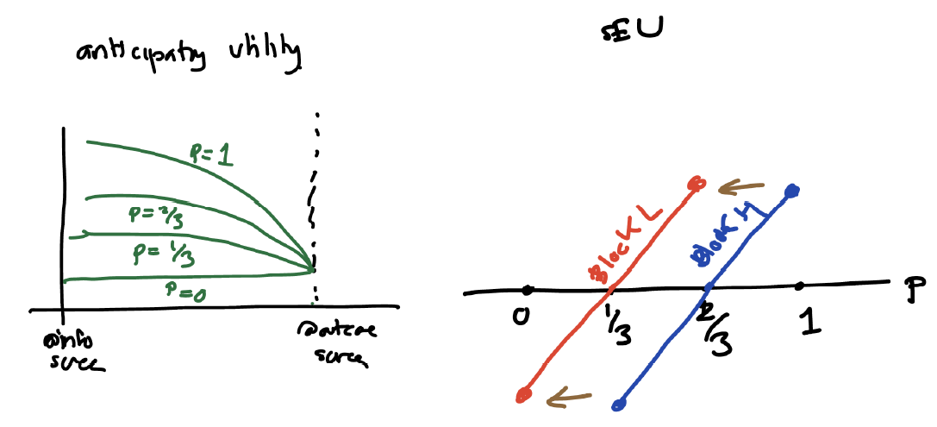
Anticipation Utility (aEU)
aEU is decreasing in proximity to reward (e.g. distance or time), unlike sEU which is a transient experience at the time of information acquisition.
@ info screen
AR Notes

Slide 54
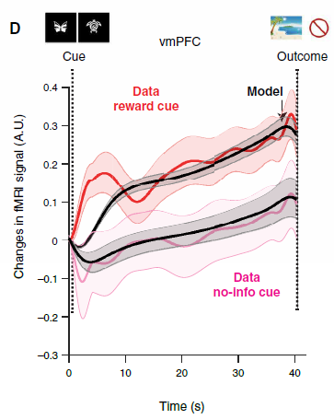
Anticipation Utility (aEU)
aEU is decreasing in proximity to reward (e.g. distance or time), unlike sEU which is a transient experience at the time of information acquisition.
Iigaya et al. (2020, Sci Adv)

Slide 55
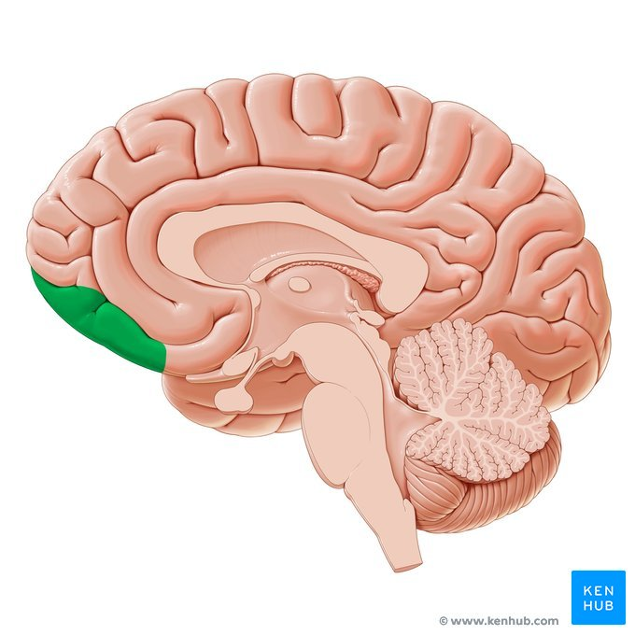



Recap
Experienced Utility = Consumption + Surprise
at time of news
at time of consumption

